Slide 1
IEEE Standards
Dr. S.L.JAYALAKSHMI, VIT Chennai

Slide 2
Outline
Wireless
IEEE 802.11
IEEE 802.15.1

Slide 3
IEEE 802.11
Basics
Standard for Wireless Local Area Network (WLAN)
Commonly known as WiFi
Data transmission using Electromagnetic Spectrum:
Radio Waves, Infrarred
License free –ISM(Industrial, Scientific and Medical) band 2.4 GHz
Only a support to wired network – not a replacement
Notes:
Wireless LANs are those Local Area Networks that use high frequency radio waves instead of cables for connecting the devices in LAN. Users connected by WLANs can move around within the area of network coverage. Most WLANs are based upon the standard IEEE 802.11 or WiFi.

Slide 4
IEEE 802.11 Architecture
The components of an IEEE 802.11 architecture are as follows:
1) Stations (STA) − Stations comprise all devices and equipments that are connected to the wireless LAN. A station can be of two types:
Wireless Access Points (WAP) − WAPs or simply access points (AP) are generally wireless routers that form the base stations or access.
Client. − Clients are workstations, computers, laptops, printers, smartphones, etc.
Each station has a wireless network interface controller.
2) Basic Service Set (BSS) −A basic service set is a group of stations communicating at physical layer level. BSS can be of two categories depending upon mode of operation:
Infrastructure BSS − Here, the devices communicate with other devices through access points.
Independent BSS − Here, the devices communicate in peer-to-peer basis in an ad hoc manner.
3) Extended Service Set (ESS) − It is a set of all connected BSS.
4) Distribution System (DS) − It connects access points in ESS.

Slide 5






Architecture – Basic Service Set (BSS)
Infrastructure Ad-hoc
Access Point (AP)
Station

Slide 6
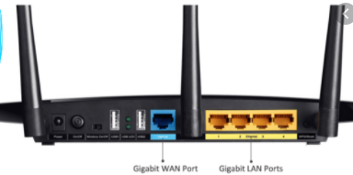
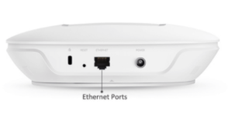
W
Wireless Access Point (AP)
Wireless Router

Slide 7
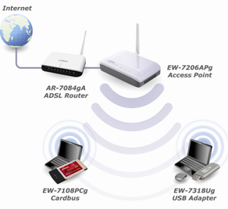

Slide 8
Architecture – Extended Service Set (ESS)
Distribution System
Source: Behrouz A Forouzan, “Data Communications and Networking”, 4th Edition

Slide 9
ADVANTAGES AND DISADVANTAGES
Advantages of WLANs
They provide clutter free homes, offices and other networked places.
The LANs are scalable in nature, i.e. devices may be added or removed from the network at a greater ease than wired LANs.
The system is portable within the network coverage and access to the network is not bounded by the length of the cables.
Installation and setup is much easier than wired counterparts.
The equipment and setup costs are reduced.
Disadvantages of WLANs
Since radio waves are used for communications, the signals are noisier with more interference from nearby systems.
Greater care is needed for encrypting information. Also, they are more prone to errors. So, they require greater bandwidth than the wired LANs.
WLANs are slower than wired LANs.

Slide 10
Station types
Based on the mobility
No transition: A station of this type is either stationary or moves only within the direct communication range of the communicating stations of a single BSS.
BSS transition: This is defined as a station movement from one BSS to another BSS within the same ESS.
ESS transition: This is defined as a station movement from a BSS in one ESS to a BSS within another ESS.
IEEE 802.11 does not guarantee that communication is continuous during the move.

Slide 11
Association
Active Scanning
Passive Scanning
Probe request frame
Probe request frame
Beacon
frame
Beacon
frame
Probe response
frame
Probe response
frame
Association request
frame
Association response frame
Association request
frame
Association response frame
Notes:
The WLAN clients or stations use probe request frame to scan the area for availability of WLAN network.
Beacon frame is one of the management frames in IEEE 802.11 based WLANs. It contains all the information about the network. Beacon frames are transmitted periodically, they serve to announce the presence of a wireless LAN and to synchronise the members of the service set.

Slide 12
IEEE 802.11
Physical Layer – various amendments available based on
Bandwidth
Encoding scheme
Frequency Hopping Spread Spectrum (FHSS)
Direct Sequence Spread Spectrum (DSSS)
Orthogonal Frequency Division Multiplexing (OFDM)
Speed : 1 , 2, 5.5, 11, 54 Mbps
Range 250 METERS

Slide 13
IEEE 802.11 (contd.)
Data Linked Layer
2 -MAC sublayer
Distributed Coordination Function (DCF)
Contention-based service
Mandatory
Point Coordination Function (PCF)
Contention-free service
Optional

Slide 14
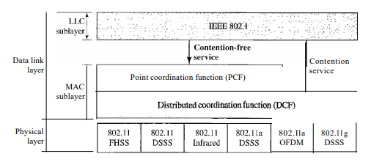
MAC SUBLAYER

Slide 15
Distributed Coordination Function (DCF)
Multiple stations contend with each other to access carrier
CSMA/CA (Carrier Sense Multiple Access /Collision Avoidance)
Reasons for not using Collision Detection:
Stations are half duplex
Signal strength is very low
Hidden station problem

Slide 16
CSMA/CA
Sender
Carrier
Receiver
Other Station
Other Station
Check if free
Wait for DIFS
Request to Send (RTS)
Wait for SIFS
Wait for NAV (Network Allocation Vector)
Clear to Send (CTS)
Wait for SIFS
Data
Wait for SIFS
Acknowledgement
DIFS – Distributed Interframe space SIFS – Short Interframe space
Source: Behrouz A Forouzan, “TCP/IP Protocol Suite”, 4th Edition
Notes:
STEPS
Before sending a frame, the source station senses the medium by checking the energy level at the carrier frequency. a. The channel uses a persistence strategy with back-off until the channel is idle. b. After the station is found to be idle, the station waits for a period of time called the distributed interframe space (DIFS); then the station sends a control frame called the request to send (RTS). 2. After receiving the RTS and waiting a period of time called the short interframe space (SIFS), the destination station sends a control frame, called the clear to send (CTS), to the source station. This control frame indicates that the destination station is ready to receive data. 3. The source station sends data after waiting an amount of time equal to SIFS. 4. The destination station, after waiting an amount of time equal to SIFS, sends an acknowledgment to show that the frame has been received. Acknowledgment is needed in this protocol because the station does not have any means to check for the successful arrival of its data at the destination. On the other hand, the lack of collision in CSMAlCD is a kind of indication to the source that data have arrived
NAV
Network Allocation Vector How do other stations defer sending their data if one station acquires access? In other words, how is the collision avoidance aspect of this protocol accomplished? The key is a feature called NAV. When a station sends an RTS frame, it includes the duration oftime that it needs to occupy the channel. The stations that are affected by this transmission create a timer called a network allocation vector (NAV) that shows how much time must pass before these stations are allowed to check the channel for idleness. Each time a station accesses the system and sends an RTS frame, other stations start their NAV. In other words, each station, before sensing the physical medium to see if it is idle, first checks its NAV to see if it has expired.

Slide 17
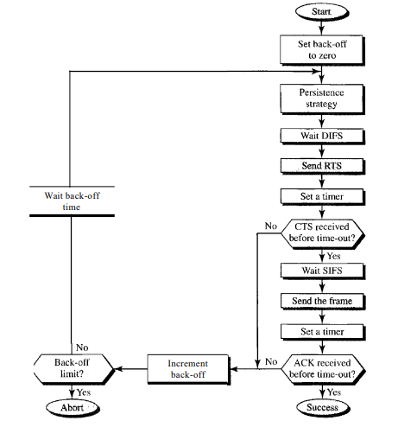
CSMA/CA

Slide 18
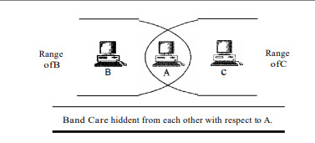
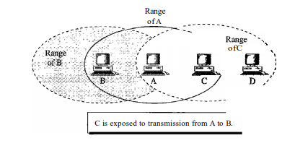
Problems Solved by CSMA/CA
Hidden Station Problem Exposed Station Problem
Send data Send data Currently sending data Waiting to send data
S1
R1
S2
R1
S1
S2
R2
S1
R1
R1
S1
S2
S2
R2
Notes:
Hidden Station Problem: Station B has a transmission range shown by the left oval (sphere in space); every station in this range can hear any signal transmitted by station B. Station C has transmission range shown by the right oval (sphere in space); every station located in this range can hear any signal transmitted by C. Station C is outside the transmission range of B; likewise, station B is outside the transmission range of C. Station A, however, is in the area covered by both Band C; it can hear any signal transmitted by B or C. Assume that station B is sending data to station A. In the middle of this transmission, station C also has data to send to station A. However, station C is out of B's range and transmissions from B cannot reach C. Therefore C thinks the medium is free. Station C sends its data to A, which results in a collision at A because this station is receiving data from both B and C.
In this case, we say that stations Band C are hidden from each other with respect to A. Hidden stations can reduce the capacity of the network because of the possibility of collision. The solution to the hidden station problem is the use of the handshake frames (RTS and CTS) that we discussed earlier. Figure 14.11 shows that the RTS message from B reaches A, but not C. However, because both Band C are within the range of A, the CTS message, which contains the duration of data transmission from B to A reaches C. Station C knows that some hidden station is using the channel and refrains from transmitting until that duration is over.

Slide 19
Point Coordination Function (PCF)
Station requiring
contention free service
Other Station
Other
Station
Access
Point
Wait for PIFS
Beacon Frame
Wait for SIFS
Poll Frame
Wait for SIFS
Wait for NAV (Network Allocation Vector)
Acknowledgement
Data
Wait for SIFS
Acknowledgement
Contention free frame
Notes:
The point coordination function (PCF) is an optional access method that can be implemented in an infrastructure network (not in an ad hoc network). It is implemented on top of the DCF and is used mostly for time-sensitive transmission. PCF has a centralized, contention-free polling access method. The AP performs polling for stations that are capable of being polled. The stations are polled one after another, sending any data they have to the AP. To give priority to PCF over DCF, another set of interframe spaces has been defined: PIFS and SIFS. The SIFS is the same as that in DCF, but the PIFS (PCF IFS) is shorter than the DIFS. This means that if, at the same time, a station wants to use only DCF and an AP wants to use PCF, the AP has priority.

Slide 20
IEEE 802.15

Slide 21
IEEE 802.15.1 - Bluetooth
WLAN technology to connect devices of different functions
Ad-hoc network
License free band of 2.45 Ghz
Bandwidth: 1-3 Mbps
Range: ~10 metres
Low power consumption

Slide 22
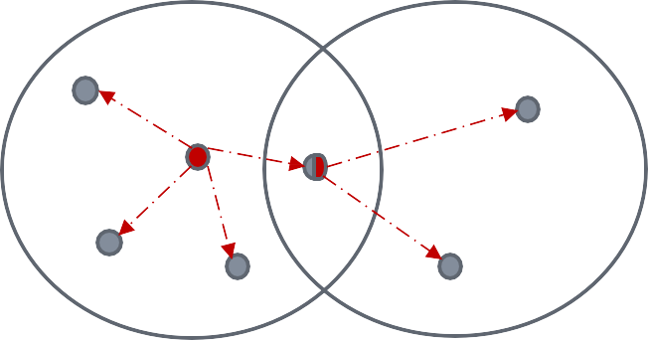
Architecture
Piconet
1 master & upto 7 slaves
Communication only between master and slave
State of a slave:
Active
Parked
Scatternet

